Slide 1
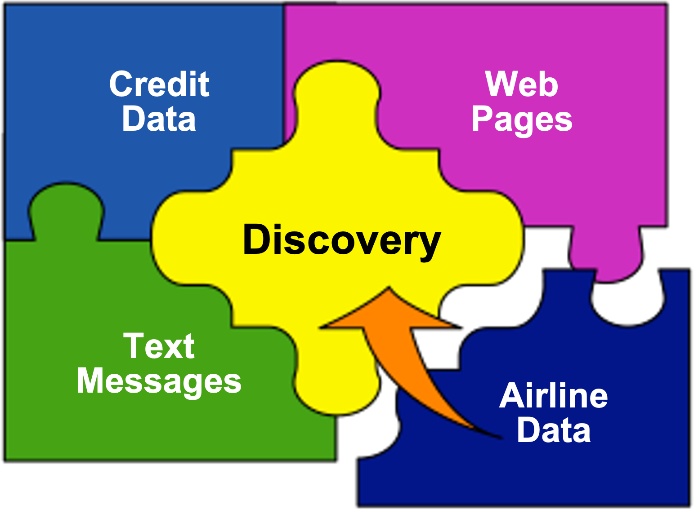
Sample Poster Title
Problem
Results
Set the context for the work, Don’t make the reviewer guess what problem this work solves. Scientific question? Deficiency? Linkage to user requirements? Mention any DoD cyber, electro-magnetic spectrum relevance.
So what? Impact? What has been accomplished? Include some quantitative depiction of tangible progress, e.g. graphs, photos.
Next Steps
Key Ideas
What are the next steps in the research? What organizations are possible end users?
What’s novel/important?
What’s the ”it”?
Technical Approach/Methodology
Figure X: If you have a graphic, it might be useful to include a subtitle such as this one to identify its relevance.
One Global Picture
Wired & Wireless
Outline the investigations or experiments.
Use of modeling & sim or computational environment?
Mathematical basis?
Use
Data
High Quality Data Content
Anywhere
Data
Mining
JAVA=
Any Box
FBI/CIA’s CTC, DEA, GCSS, DIA, and related CIV/MIL Databases
Capture
the Data
Figure X. If you have a graphic, it might be useful to include a subtitle such as this one to identify its relevance.
Team
VI School(s)
Scholar participants
Lead PI/Mentor
Figure X. If you have a graphic, it might be useful to include a subtitle such
as this one to identify its relevance.
Place proper DISTRIBUTION statement here
Place POSTER POC NAME here
Notes:
s

